Slide 1

Name: Sokomba Chalcedony Ariel Course: Computer Science Institution: Lincoln College of Science, Management and Technology Student ID: LUC-NGA-002-ADM-100817 Semester: 4 Program: Project skill application

Slide 2

Introducing S3, a platform that provides free coding courses to help you unlock your potential as a developer

Slide 3

INTRODUCTION
S3 is a non-governmental organization dedicated to bridging the knowledge gap in technical skills, particularly in coding, software development languages. The mission is to empower individuals with the know-how to thrive in the digital economy
OUR GOAL IS:
- Empower Individuals - Bridge the skills gap - Promote innovation

Slide 4
INTRODUCTION TO PROBLEM STATEMENT
SOLUTION TO PROBLEM
- Creating a strong online presence - Developing a website and mobile app solution using Laravel and React Native - Offering customer support
Despite its technical expertise, Sevlent Software Solutions lacked a strong digital presence, making it difficult for potential clients to interact with the firm. This lack of online presence limited the firm's market visibility and hindered its ability to engage with customers, build brand recognition, and grow in the modern digital
landscape.

Slide 5
SOLUTION STATEMENT
To enhance growth, brand recognition, and client engagement, Sevlent Software Solutions should prioritize a robust digital presence. As part of this effort, I developed a web and mobile solution using Laravel for the
website and React Native for the mobile application.

Slide 6
SKILLS AQUIRED
I have gained hands-on experience in developing web applications and mobile
apps using React.js and Laravel. My expertise includes designing and implementing user interfaces, and integrating third-party services. By leveraging my technical expertise and experience, we can create a
user-friendly web application and mobile app that meet your requirements and exceed your expectations.

Slide 7
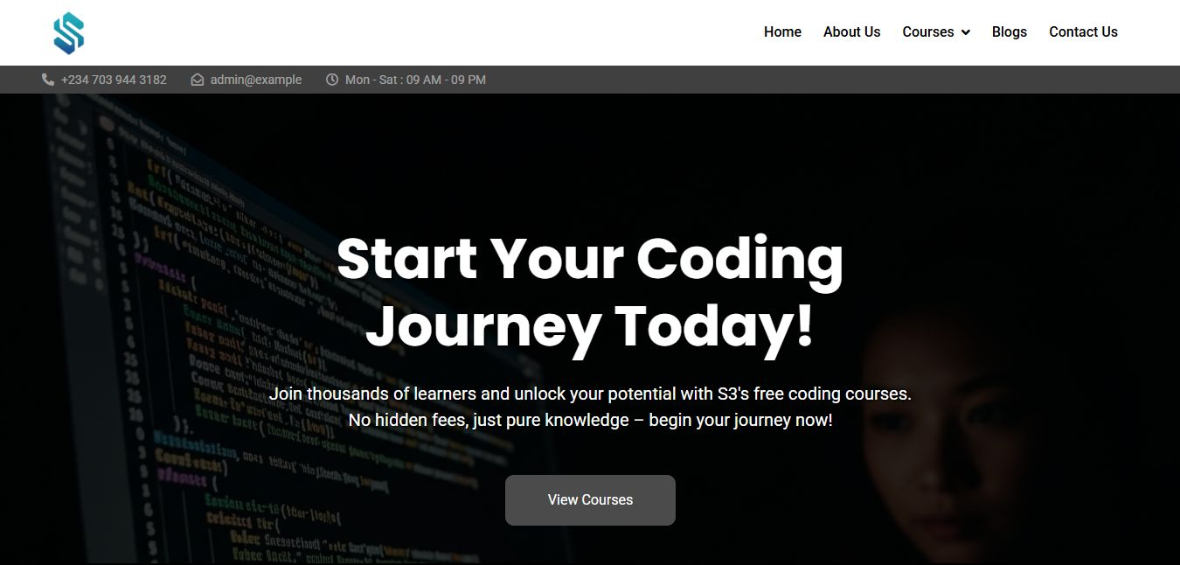
SCREENSHOTS (Website)
Embodies the described welcoming atmosphere:
Clear call-to-action ("View Courses" button, functionally equivalent to "Order Now")
Warm invitation ("Start Your Coding Journey Today!")
Supportive details (free courses, accessible hours)
Relaxed tone ("unlock your potential," "no hidden fees")

Slide 8
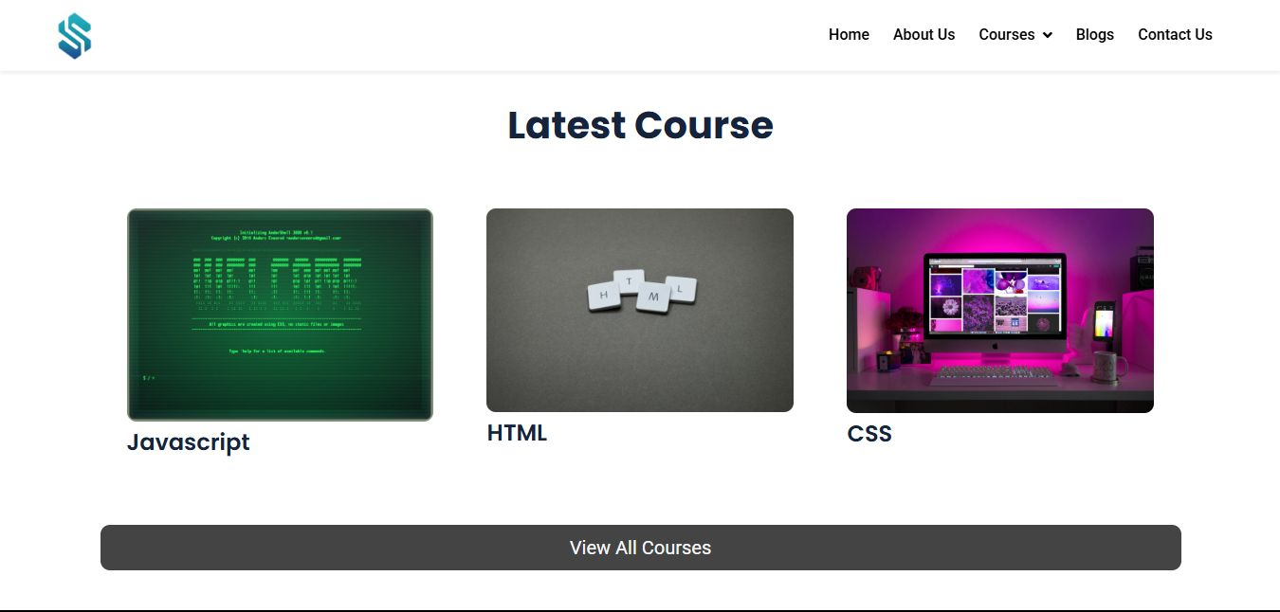
Highlighting the core structure:
Simple top menu (Home, Courses, Blogs, Contact Us)
Prominent "View All Courses" button (primary action)
Clean course listings (JavaScript, HTML, CSS)

Slide 9
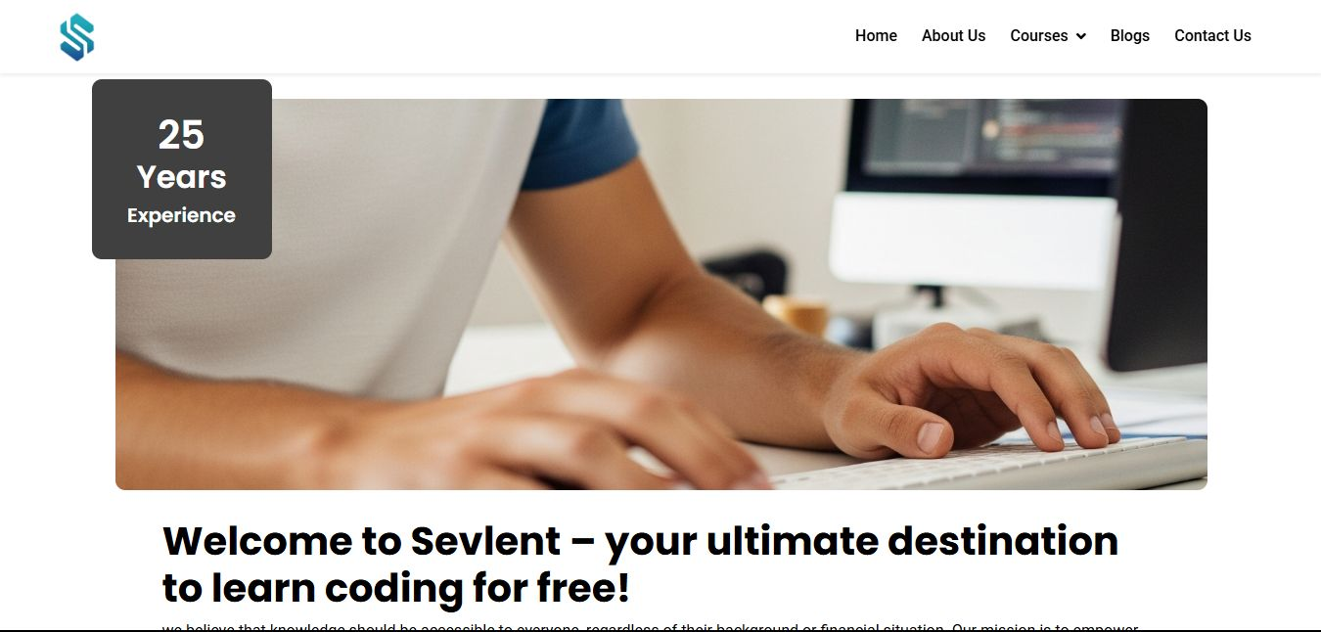
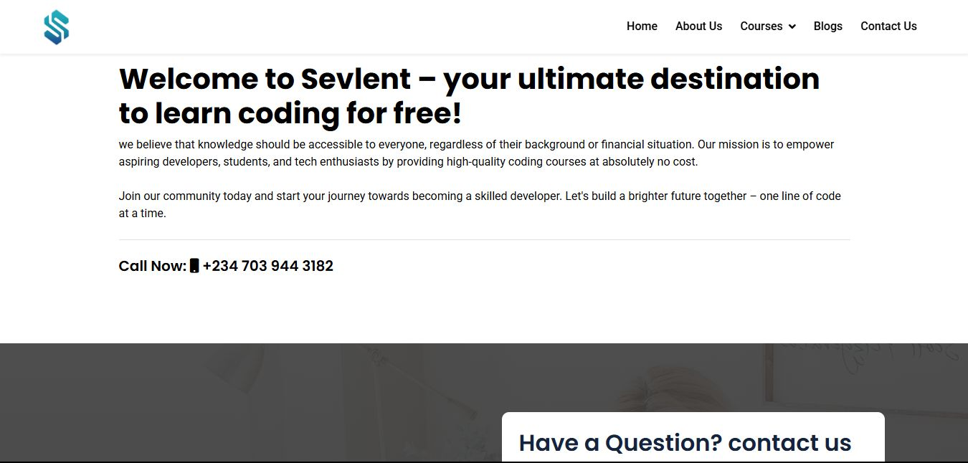
Completes the welcoming atmosphere described earlier: - Warm Introduction and Mission-Driven Narrative The heartfelt mission statement ("we believe knowledge should be accessible...") reinforces the cozy, inclusive vibe by emphasizing accessibility and empowerment.

Slide 10
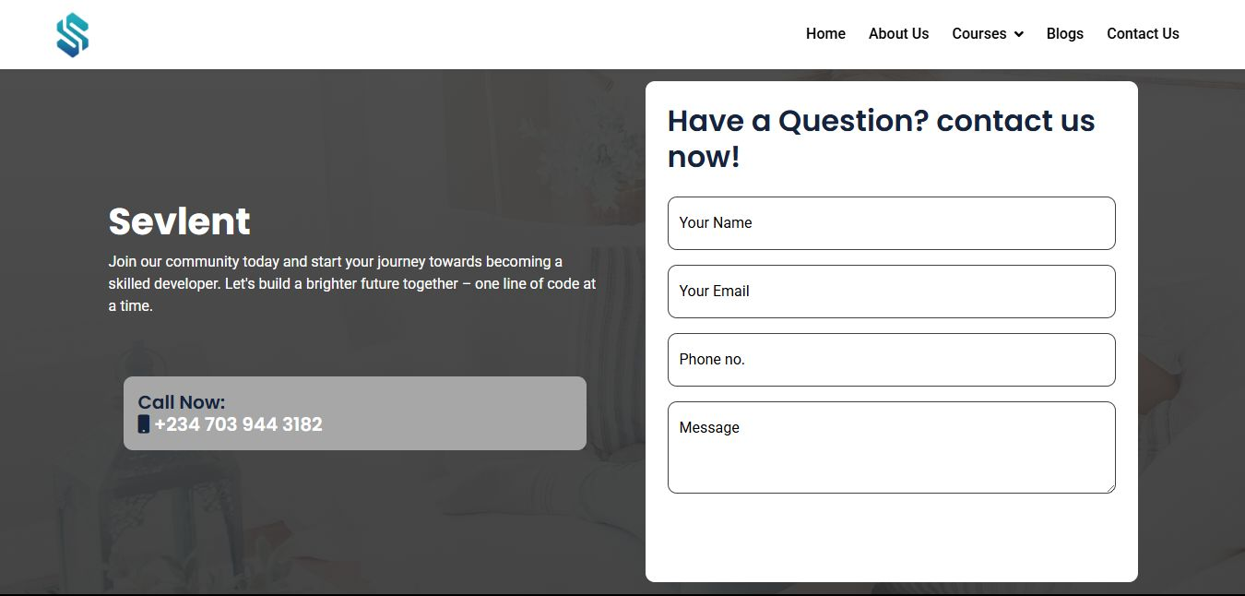
The minimalist, trust-building design features a clean layout with ample whitespace for enhanced readability, subtly placed 'Sevient' branding, and duplicated phone numbers to ensure visibility

Slide 11
IMPACT TO THE SOCIETY/OUTCOME
Sevlent Software Solutions (S3) now delivers accessible tech education for beginners through a dedicated mobile learning platform and a W3Schools-inspired website. This project empowers users to discover reliable, beginner-friendly programming resources—bridging the gap for learners without access to formal education.

Slide 12
END

